Slide 1
Using Office 365 Applications Offline

Slide 2
In this lesson, you will learn how to:
Access Settings
Upload a profile picture to your device,
Sync your Microsoft School account with Office 365 applications on your device for offline use,
Use Cortana search to find installed applications, and
Pin applications to your Taskbar.

Slide 3
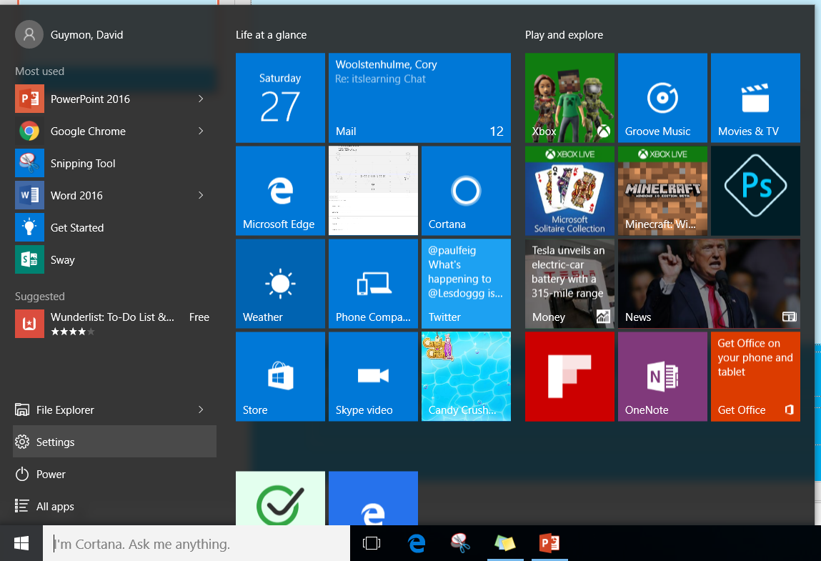
Navigate to Settings by clicking on the Start (Windows) icon in the lower-left corner of your desktop screen.

Slide 4
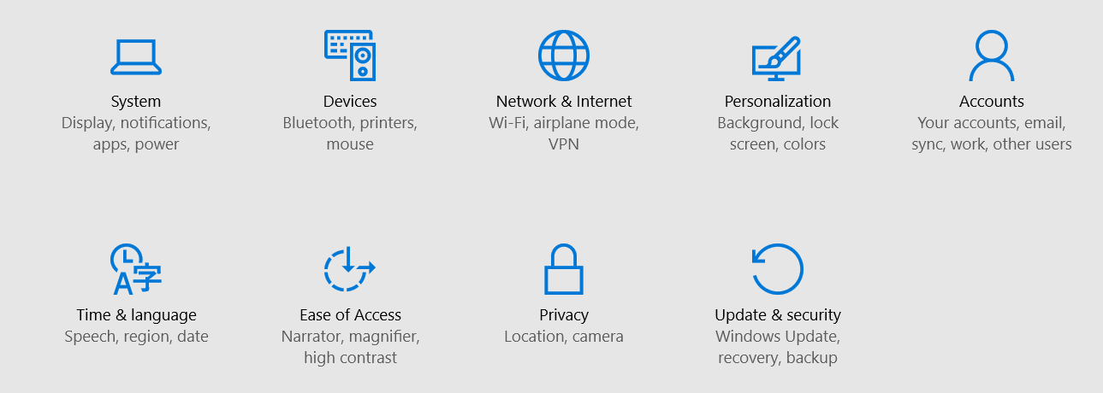
On the Settings screen, click on Accounts.

Slide 5
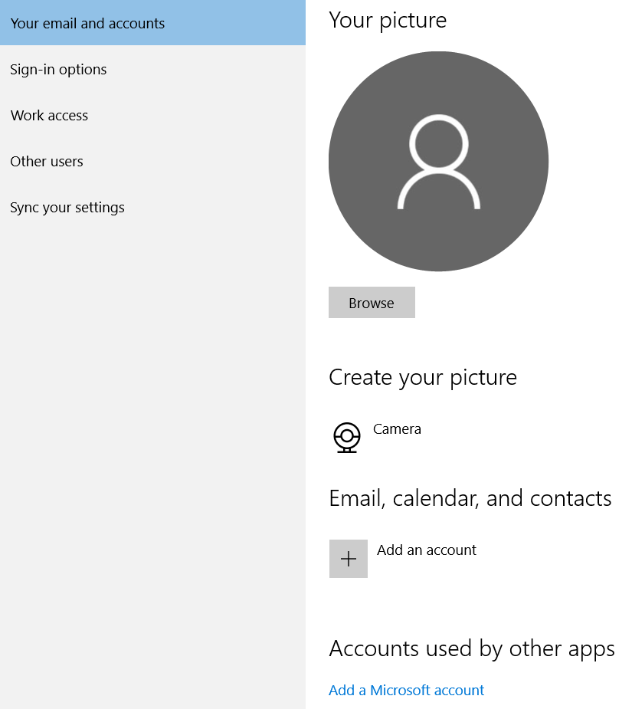
On the Your email and accounts tab, you are going to: 1) add a profile picture (optional), 2) add your Microsoft School account to Email, calendar, and contacts, and 3) add your Microsoft School account to Accounts used by other apps.
1
2
3

Slide 6
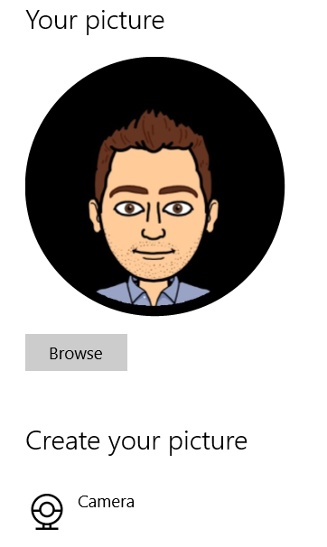
To add a profile picture, you can either upload a picture from your computer or take a picture with the camera. Your profile picture will appear in two places: 1) On the NSD sign-in screen on your device, and 2) In your Office 365 applications when collaborating with others.

Slide 7
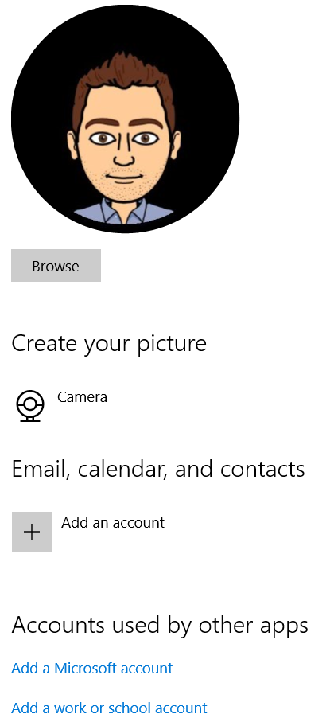
To add your Microsoft School account, click on the blue link that says “Add a work or school account”. You can find this at the bottom of the pop-up window.

Slide 8
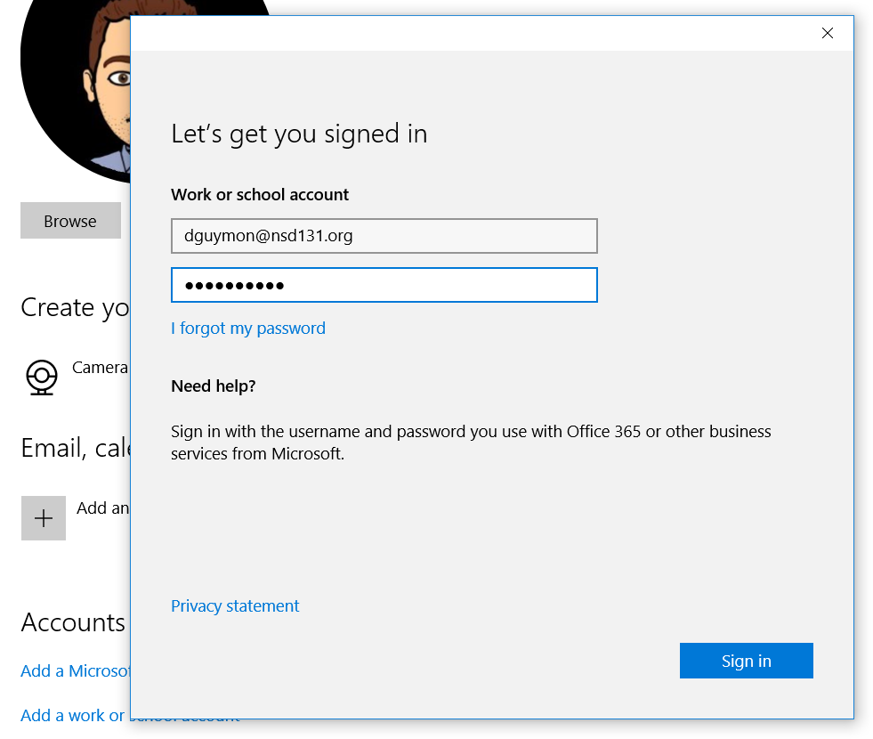
Type in your NSD email account and password into the appropriate fields. Then click Sign in.

Slide 9
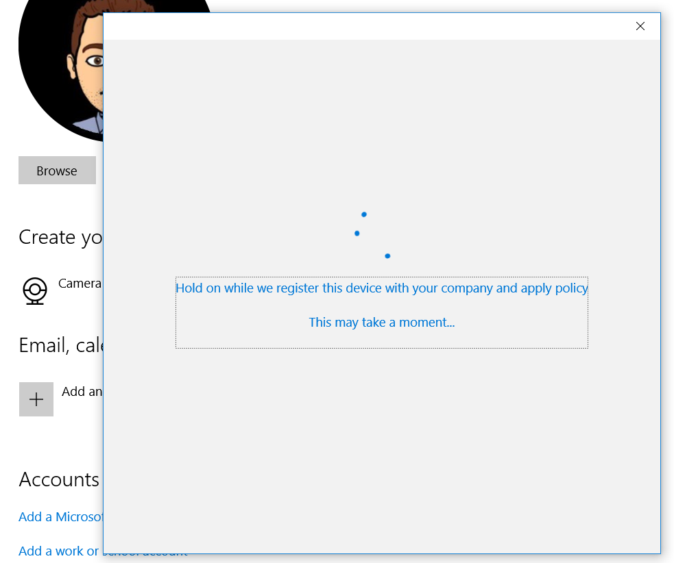
You should then be prompted to wait while your device is registered with the company (NSD). Sit tight.

Slide 10
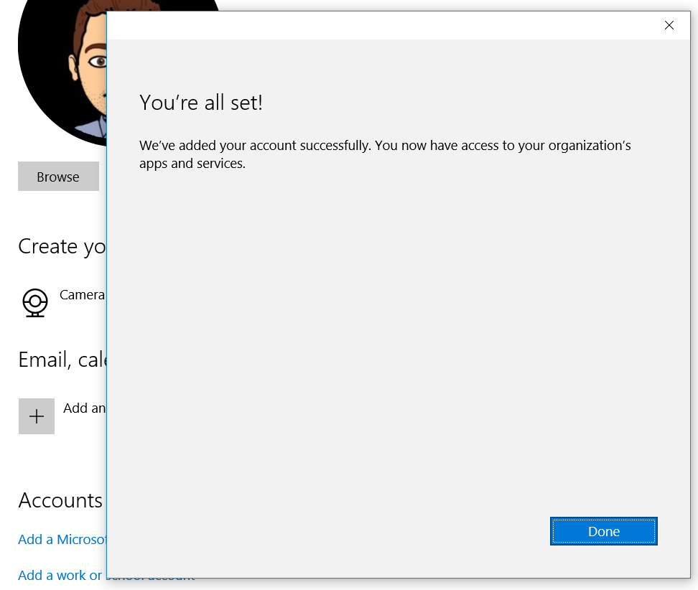
Once your device is successfully registered with NSD, click Done.

Slide 11
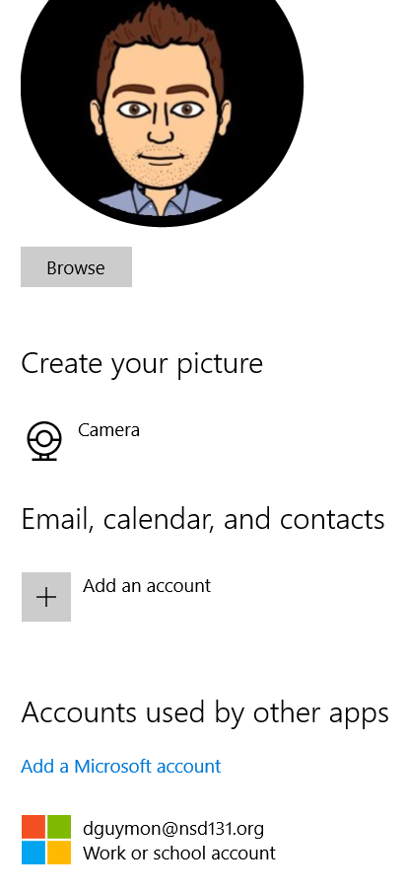
You should now be able to see your NSD email address with “Work or school account” underneath Accounts used by other apps.

Slide 12
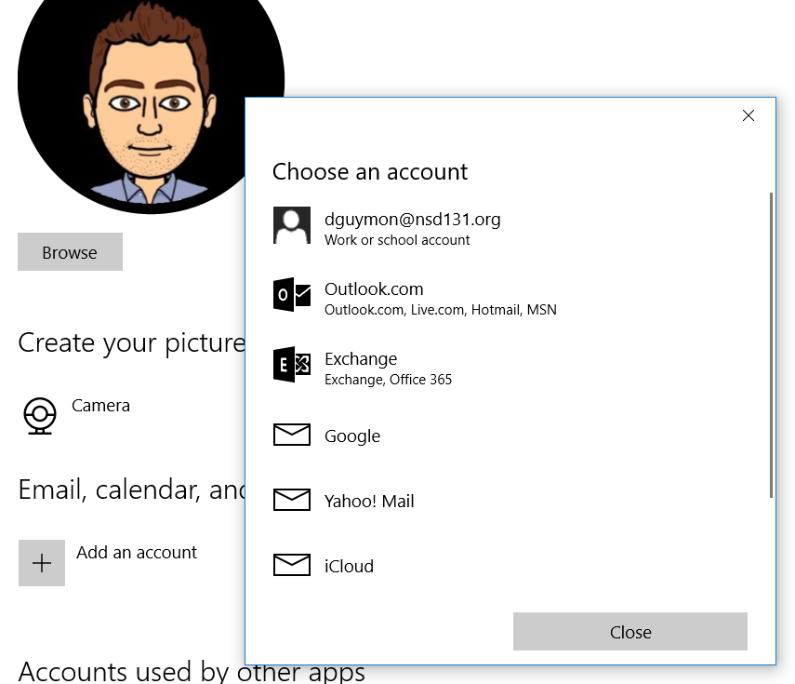
Finally, click on (+) Add an account under Email, calendar, and contacts. Click on your Work or school account from the options listed. This step will allow you to use the Outlook 2016 application installed on your device.

Slide 13
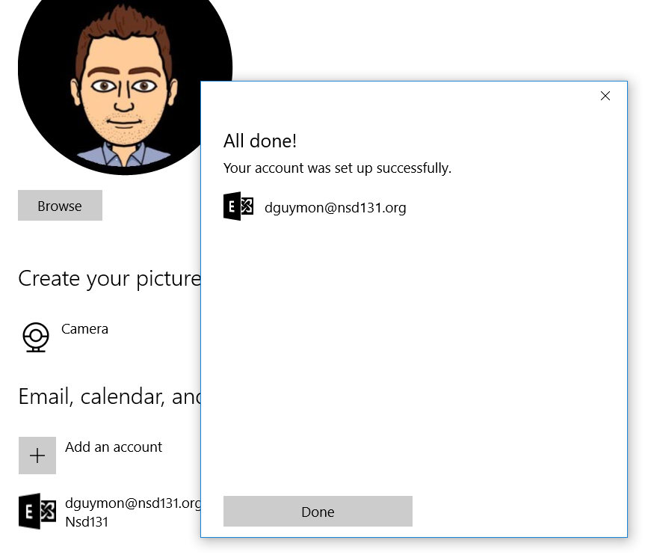
When prompted to make your device more secure by enforcing certain policies, click “Enforce policies”. You will then see a pop-up box that says “All done!” Click Done.

Slide 14
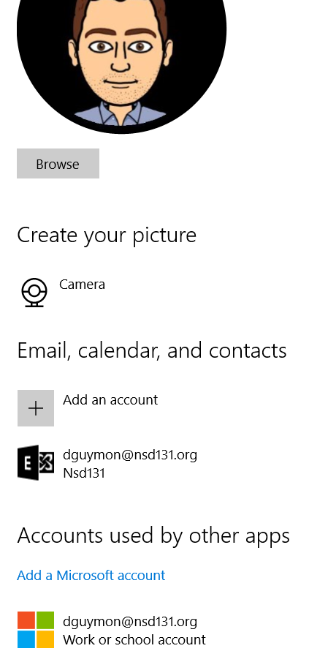
You should now be able to see your NSD email address with “Nsd131” underneath Email, calendar, and contacts. Close out of Settings by clicking on the x in the top-right corner of your screen.

Slide 15
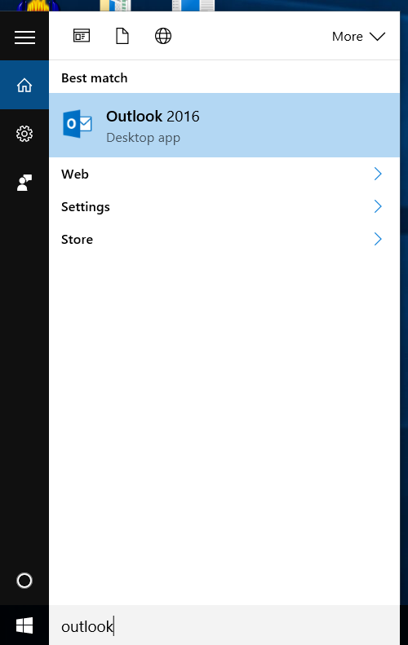
In the Cortana search box (to the right of the Start (Windows) icon, type Outlook, which is your device’s email application. Right-click while hovering over Outlook 2016 and select Pin to Taskbar. This adds an icon shortcut to Outlook to the black bar (the Taskbar) located at the bottom of your screen.

Slide 16
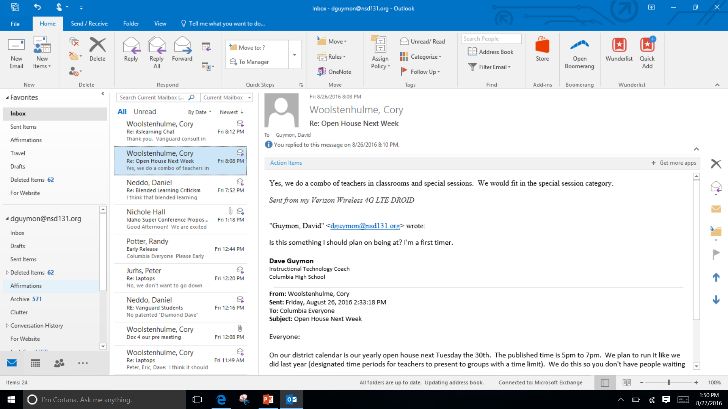
Now, when you click on the Outlook 2016 icon in your task bar, you can access your NSD email account without logging in through the District website. Whether you use the web version or Outlook 2016 in your Taskbar is up to you.

Slide 17
In addition to Outlook 2016, you can pin any applications installed on your computer to your Taskbar (see mine below).
I recommend you pin the following applications:
Outlook 2016
OneDrive
Microsoft Word
Camera
Microsoft Edge
Chrome

